Slide 1

IE 260 – ENGINEERING ECONOMY Chapter 6 Comparison and Selecting among Alternatives II
U. MAHİR YILDIRIM

Slide 2
So far
Investment and Cost Alternatives
Useful Lives are Equal to the Study Period
Useful Lives are Unequal among the Alternatives
Equivalent-worth methods
PW,
FW, and
AW
Rate-of-return methods

Slide 3
Rate-of-Return Methods
Annual return on investment is a popular metric of profitability.
Each increment of capital must justify itself by producing a sufficient rate of return (greater than or equal to MARR) on that increment.
Compare a higher investment alternative against a lower investment alternative only when the latter is acceptable. The difference between the two alternatives is usually an investment alternative and permits the better one to be determined.

Slide 4

IRRs of alternatives !
Do not compare the IRRs of mutually exclusive alternatives (or IRRs of the differences between mutually exclusive alternatives) against those of other alternatives.
Compare an IRR only against MARR (IRR ≥ MARR) in determining the acceptability of an alternative.

Slide 5
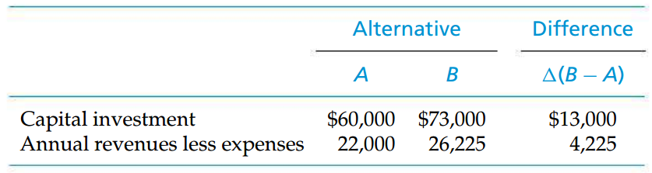
The Inconsistent Ranking Problem
Recall the example in the previous lecture;
The useful life of each alternative (and the study period) = 4 years.
MARR = 10%

Slide 6
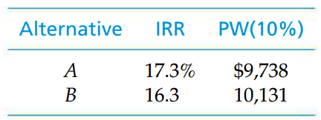
The Inconsistent Ranking Problem (cont’d)
Now that we know Alternative A is acceptable (IRR > MARR; PW at MARR > 0), we will analyze the incremental cash flow between the two alternatives, which we shall refer to as ∆(B - A).
Obviously, here we have an inconsistent ranking of the two mutually exclusive investment alternatives.
MARR = 10%
How ?

Slide 7
The Inconsistent Ranking Problem (cont’d)
When the IRR of the incremental cash flow is used, the rankings of A and B are consistent with that based on the PW on total investment.
Obviously, if the equivalent worth of the difference is greater than or equal to zero at i = MARR, then Alternative B is preferred.
Otherwise, given that Alternative A is justified (an acceptable base alternative), Alternative A is preferred.
It is always true that if PW∆ ≥ 0, then IRR∆ ≥ MARR.
The IRR of this increment, IRR∆, is 11.4% > MARR (10%)
The incremental investment of $13,000 is justified.
?

Slide 8
The Incremental Investment Analysis Procedure
Arrange (rank-order) the feasible alternatives based on increasing capital investment.
Establish a base alternative.
Cost alternatives—the first alternative (least capital investment) is the base.
Investment alternatives—if the first alternative is acceptable (IRR ≥ MARR; PW, FW, or AW at MARR ≥ 0), select it as the base. If the first alternative is not acceptable, choose the next alternative in order of increasing capital investment and check the profitability criterion (PW, etc.) values. Continue until an acceptable alternative is obtained. If none is obtained, the do-nothing alternative is selected.

Slide 9
The Incremental Investment Analysis Procedure (cont’d)
Use iteration to evaluate differences (incremental cash flows) between alternatives until all alternatives have been considered.
If the incremental cash flow between the next (higher capital investment) alternative and the current selected alternative is acceptable, choose the next alternative as the current best alternative. Otherwise, retain the last acceptable alternative as the current best.
Repeat and select as the preferred alternative the last one for which the incremental cash flow was acceptable.

Slide 10
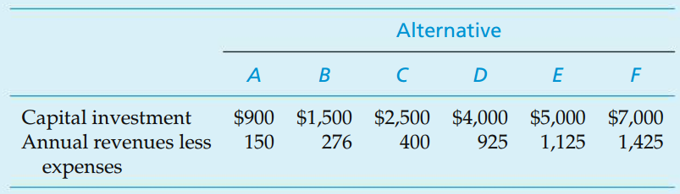
Example 1 Incremental Analysis: Investment Alternatives
Suppose that we are analyzing the following six mutually exclusive alternatives for a small investment project, using the IRR method.
The useful life of each alternative is 10 years, and the MARR is 10% per year. Also, net annual revenues less expenses vary among all alternatives. If the study period is 10 years, and the market (salvage) values are zero, which alternative should be chosen?
Notice that the alternatives have been rank-ordered from low capital investment to high capital investment.

Slide 11
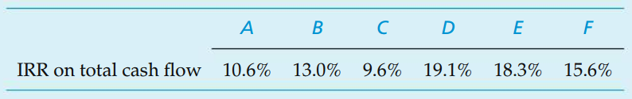
Solution 1 Incremental Analysis: Investment Alternatives
Alternative A;
For i% = IRR, PW=0, FW=0, AW=0
Using AW = 0
0 = -$900(A/P,i′ %, 10) + $150; i′% = 10.6%
Alternative D may not be the best choice, since maximization of IRR does not guarantee maximization of equivalent worth on total investment at the MARR.
!
base alternative
Because it is the mutually exclusive alternative with the lowest capital investment ($900) whose IRR (10.6%) is equal to or greater than MARR (10%).

Slide 12
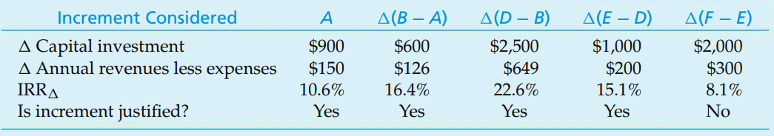
Solution 1 (cont’d) Incremental Analysis: Investment Alternatives
MARR (10%)
Alternative E will be chosen (not D) because it requires the largest investment for which the last increment of capital investment is justified.

Slide 13
Three errors commonly made in this type of analysis
Choosing the mutually exclusive alternative
with the highest overall IRR on total cash flow,
with the highest IRR on an incremental capital investment, or
with the largest capital investment that has an IRR greater than or equal to the MARR.

Slide 14
Three errors commonly made in this type of analysis (cont’d)
Error 1
Error 2
Error 3

Slide 15
Example 2 Incremental Analysis: Investment Alternatives
The owner of a downtown parking lot now determine whether it would be financially attractive to construct an office building on the site now being used for parking:
The study period is 15 years. For each plan, the property has an estimated market value that is equal to 50% of the investment cost. Comment on which plan is the best if the MARR is 10%.
 | Investment (TL) | Net Annual Revenue (TL)
P. Keep existing parking lot, but improve | 200,000 | 22,000
B1. Construct one-story building | 4,000,000 | 600,000
B2. Construct two-story building | 5,550,000 | 720,000
B3. Construct three-story building | 7,500,000 | 960,000

Slide 16
Solution 2 Incremental Analysis: Investment Alternatives
 | P | B1 | B2 | B3
Investment (TL) | 200,000 | 4,000,000 | 5,550,000 | 7,500,000
Net Revenue (TL) | 22,000 | 600,000 | 720,000 | 960,000
Market Value (TL) | 100,000 | 2,000,000 | 2,775,000 | 3,750,000
IRR | 9.3% | 13.8% | 11.6% | 11.4%
 | B1 | ∆(B2-B1) | ∆(B3-B1)
Investment (TL) | 4,000,000 | 1,550,000 | 3,500,000
Revenue (TL) | 600,000 | 120,000 | 360,000
Market Value (TL) | 2,000,000 | 755,000 | 1,750,000
IRR | 13.8% | 5.5% | 8.5%
Justifiable | Y | N | N
Base Alternative | B1 | B1 | B1
 | B1 | ∆(B2-B1) | ∆(B3-B1)
Investment (TL) | 4,000,000 | 1,550,000 | 3,500,000
Revenue (TL) | 600,000 | 120,000 | 360,000
Market Value (TL) | 2,000,000 | 755,000 | 1,750,000
IRR | 13.8% | 5.5% | 8.5%
Justifiable | Y | N | N
Base Alternative | B1 | B1 | B1

Slide 17
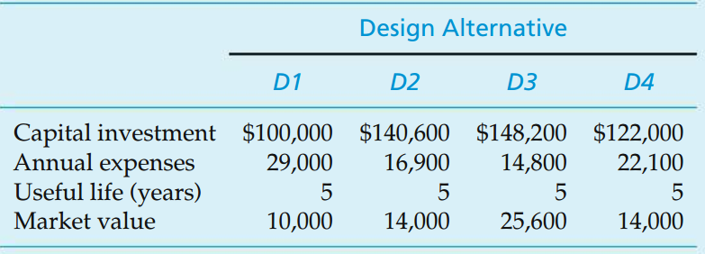
Example 3 Incremental Analysis: Cost-Only Alternatives
The study period is five years, and the MARR is 20% per year.
Determine the preferred design alternative, using the IRR method
Base alternative ?
Since these are cost alternatives, the one with the least capital investment, D1, is the base alternative.

Slide 18
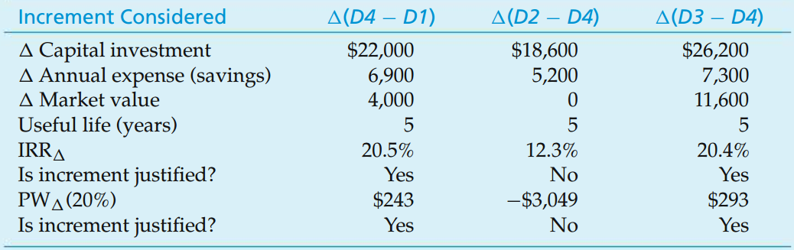
Solution 3 Incremental Analysis: Cost-Only Alternatives
Comparison of Four Cost (Design) Alternatives Using the IRR and PW Methods with Incremental Analysis

Slide 19
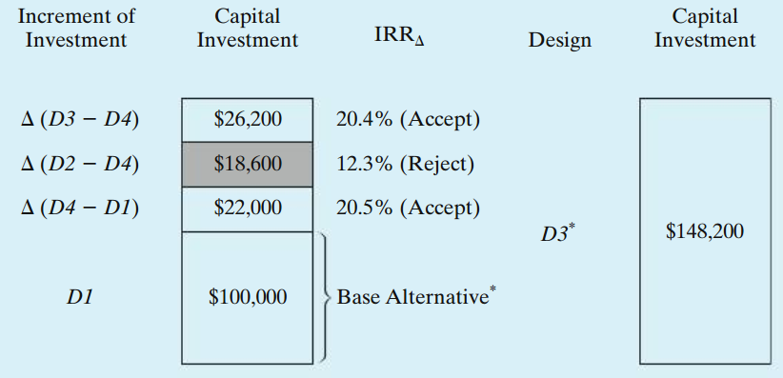
Solution 3 (cont’d) Incremental Analysis: Cost-Only Alternatives
The incremental cash flows between the cost alternatives are, in fact, investment alternatives.
D3 is the highest investment
for which each increment of investment capital is justified from the user’s
perspective.
*IRR of D3 cannot be determined since these are cost alternatives.

Slide 20
Useful Lives Are Unequal among the Alternatives
Unequal lives are handled in one of two ways;
Repeatibility assumption
Coterminated assumption
Repeatability assumption
The economic estimates for an alternative’s initial useful life cycle will be repeated in all subsequent replacement cycles.
When this assumption is applicable to a decision situation, it simplifies comparison of the mutually exclusive alternatives.

Slide 21
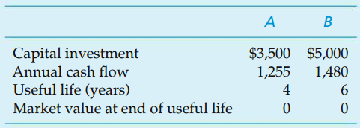
Example 4 Useful Lives ≠ Study Period: The Repeatability Assumption
If MARR = 10% per year, show which alternative is more desirable by using equivalent-worth? Use the repeatability assumption.

Slide 22
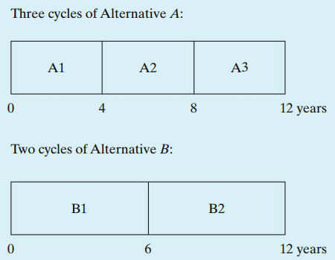
Solution 4 Useful Lives ≠ Study Period: The Repeatability Assumption
The least common multiple of the useful lives of Alternatives A and B is 12 years. Using the repeatability assumption and a 12-year study period, the first like (identical) replacement of Alternative A would occur at EOY four, and the second would be at EOY eight. For Alternative B, one like replacement would occur at EOY six.

Slide 23
Solution 4 Useful Lives ≠ Study Period: The Repeatability Assumption
Alternative A:
A = 1255
A = 1255
A = 1255
0
3500
3500
3500

Slide 24
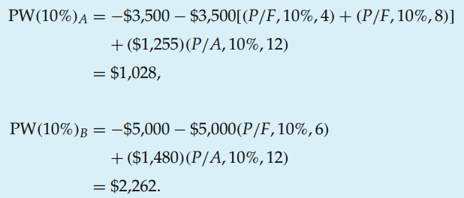
Solution (cont’d) Useful Lives ≠ Study Period: The Repeatability Assumption
Solution by the PW Method
Based on the PW method, we would select Alternative B.

Slide 25
AW and repeatability assumption
A = 1255
A = 150.75
0
0
4
1255 – 3500(A/P, 10%, 4)
4
3500
A = 1255
1255 – 3500(A/P, 10%, 12) – 3500(A/P, 10%, 8)
– 3500(A/P, 10%, 4)
A = 150.75
0
0
4
8
12
4
8
12
3500
3500
3500

Slide 26
AW and repeatability assumption
When the repeatability assumption is applied, simply compare the AW amounts of each alternative over its own useful life and select the alternative that maximizes AW.

Slide 27
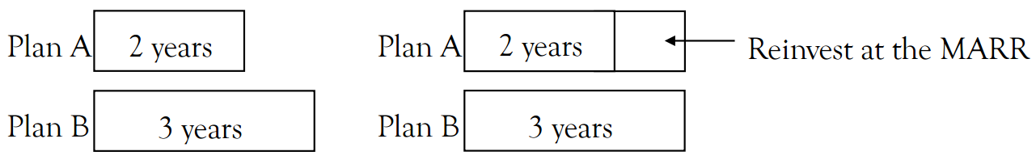
Useful Lives Are Unequal among the Alternatives (cont’d)
If the repeatability assumption is not applicable (i.e. the alternatives cannot be repeated);
The longest useful life among the two alternatives is chosen as reference. We re-invest the capital at the MARR for the remaining periods of the alternative that has a shorter useful life.
Known as Coterminated Assumption

Slide 28
Example 5 Useful Lives ≠ Study Period: The Coterminated Assumption
Perhaps the responsible manager did not agree with the repeatability assumption and wanted a six-year analysis period because it is the planning horizon used in the company for small investment projects.
If MARR = 10% per year, show which alternative is more desirable by using future-worth of alternatives?

Slide 29
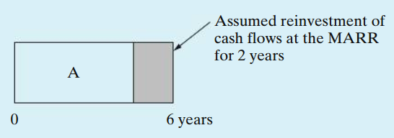
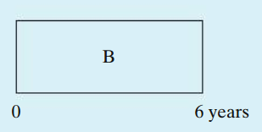
Solution 5 Useful Lives ≠ Study Period: The Coterminated Assumption
An assumption used for an investment alternative (when useful life is less than the study period) is that all cash flows will be reinvested by the firm at the MARR until the end of the study period.
This assumption applies to Alternative A, which has a four-year useful life (two years less than the study period)
This F at the end of the 4th year is going to be invested again with MARR
4

Slide 30
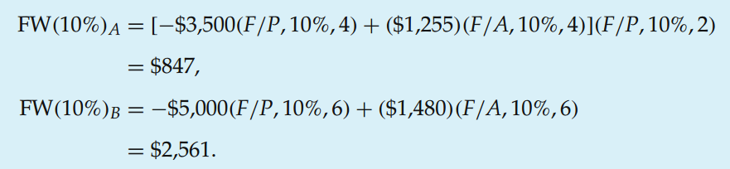
Solution 5 (cont’d) Useful Lives ≠ Study Period: The Coterminated Assumption
Based on the FW of each alternative at the end of the six-year study period, we would select Alternative B because it has the larger value ($2,561).
Future worth at the end of the 4th year that is reinvested

Slide 31
Example 6 2 broaching machine alternatives
Three products will be manufactured in a new facility at the Apex Manufacturing Company. They each require an identical manufacturing operation, but different production times, on a broaching machine. Two alternative types of broaching machines (M1 and M2) are being considered for purchase. One machine type must be selected.
For the same level of annual demand for the three products, annual production requirements (machine hours) and annual operating expenses (per machine) are listed next. Which machine should be selected if the MARR is 20% per year? Show all work to support your recommendation.
2 machine alternatives.
MARR = 20%
Which one should be chosen?

Slide 32
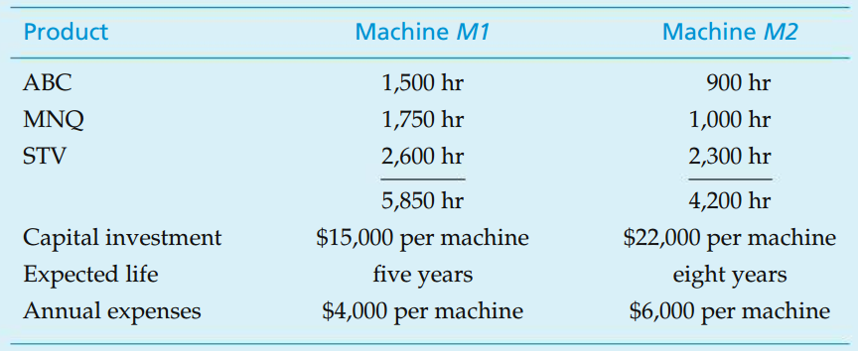
Example 6 (cont’d) 2 broaching machine alternatives
Assumptions
The facility will operate 2,000 hours per year.
Machine availability is 90% for M1 and 80% for M2.
The yield of M1 is 95%, and the yield of M2 is 90%.
Annual operating expenses are based on an assumed operation of 2,000 hours per year, and workers are paid during any idle time of M1 or M2.
Market values of both machines are negligible.

Slide 33
Solution 6 2 broaching machine alternatives
The company will need
5,850 hours/[2,000 hours (0.90)(0.95)] = 3.42 (four machines of type M1) or
4,200 hours/[2,000 hours (0.80)(0.90)] = 2.92 (three machines of type M2).
The annual cost of ownership, assuming a MARR = 20% per year
$15,000(4)(A/P, 20%, 5) = $20,064 for M1 and
$22,000(3)(A/P, 20%, 8) = $17,200 for M2.
The annual expense for the operation (operator is paid for idle time)
4 machines × $4,000 per machine = $16,000 for M1 and
3 machines × $6,000 per machine = $18,00 for M2.
The total equivalent annual cost
$20,064 + $16,000 = $36,064 for M1 and
$17,200 + $18,000 = $35,200 for M2.
Machine 2 is preferred.

Slide 34
End of Chapter 6

